Slide 1


Slide 2

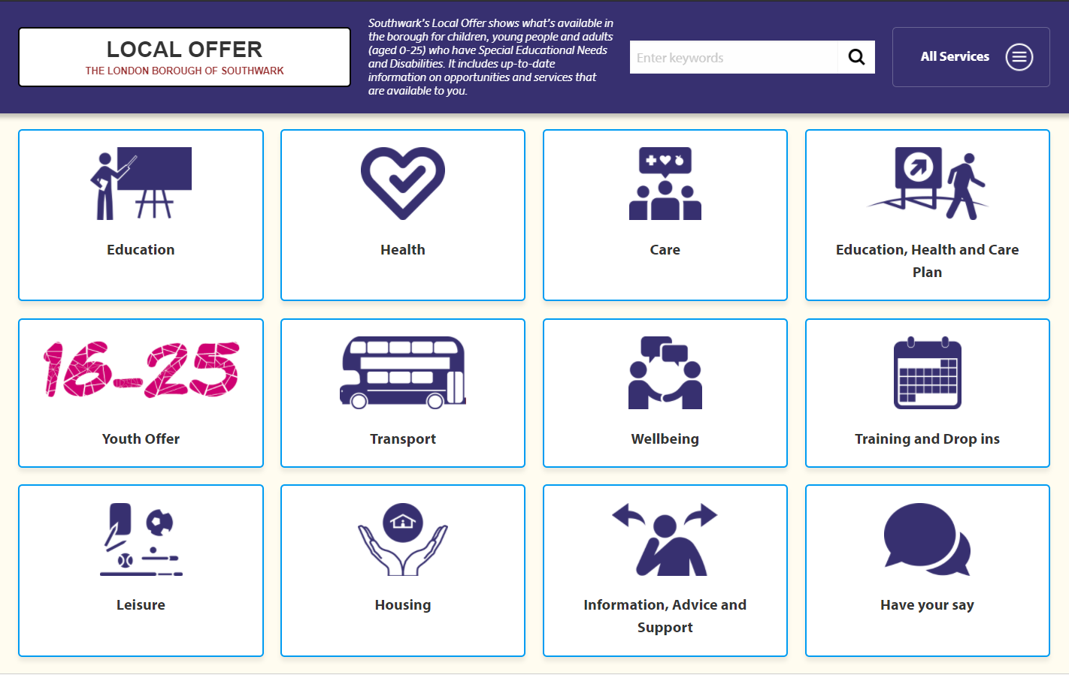
Southwark Information Advice and Support (SIAS)
Impartial advice
Manage the Southwark Local Offer
Support with appeals
Work in partnership with families

Slide 3
Type of Schools
Academies
Harris Academy, City of London Academy
Voluntary Aided
Notre Dame, St. Thomas the Apostle (STAC)
Free School
Haberdashers’ Askes Borough Academy, Charter
Resource Base Schools
London Nautical School, City of London Academy
See the ‘Education’ section of www.Localoffer.southwark.gov.uk for more information
School ED

Slide 4

Special Schools
School
Newlands Academy
Highshore
Spa School
Tuke School
Type
Social emotional & Mental Health
Mixed Needs
Autism Specialist
Severe and Complex Needs

Slide 5

Education, Health and Care Plan (EHCP)
An Education, Health & Care plan (EHCP) is required in order to apply for a Resource Base or Special School
There is a different school application process for children who have an EHCP

Slide 6

Year 5 Annual Review
The secondary school transition/transfer should be discussed at the Year 5 Annual Review
Opportunity to discuss potential schools i.e. mainstream and specialist
The plan MUST be up to date and reflective of child’s current needs:
  This is the time to raise any concerns about the contents of the plan as this is what schools will be consulted on

Slide 7

Choosing a School
Check school websites for details of how children with individual needs are supported (Ofsted and SEND information reports)
Visit as many schools as possible. Check websites in advance for details of alternative arrangements linked to Covid 19
(For those with an EHCP) Do not limit your visits to a particular type of school, consider all options (mainstream and specialist)
Make a note in advance of key factors important to you and your child
Speak with staff, including the SENCo if possible, to get an understanding of how the school could support your child
Note the pros and cons of each school to help you order your preferences

Slide 8
Applying with an EHCP
Secondary Transfer pack will be sent out during July 2021. This will be from the SEN (Special Educational Needs) Team
If you have not received this by 1st September 2021, contact the SEN team or SIAS
Do not complete the online application process managed by the School Admissions team
You can submit THREE preferences
Listing one school does not maximise chances
The SEN team ‘consult’ with each of your school choices. This means that they ask schools if they feel able to meet your child’s needs as described in the EHCP

Slide 9
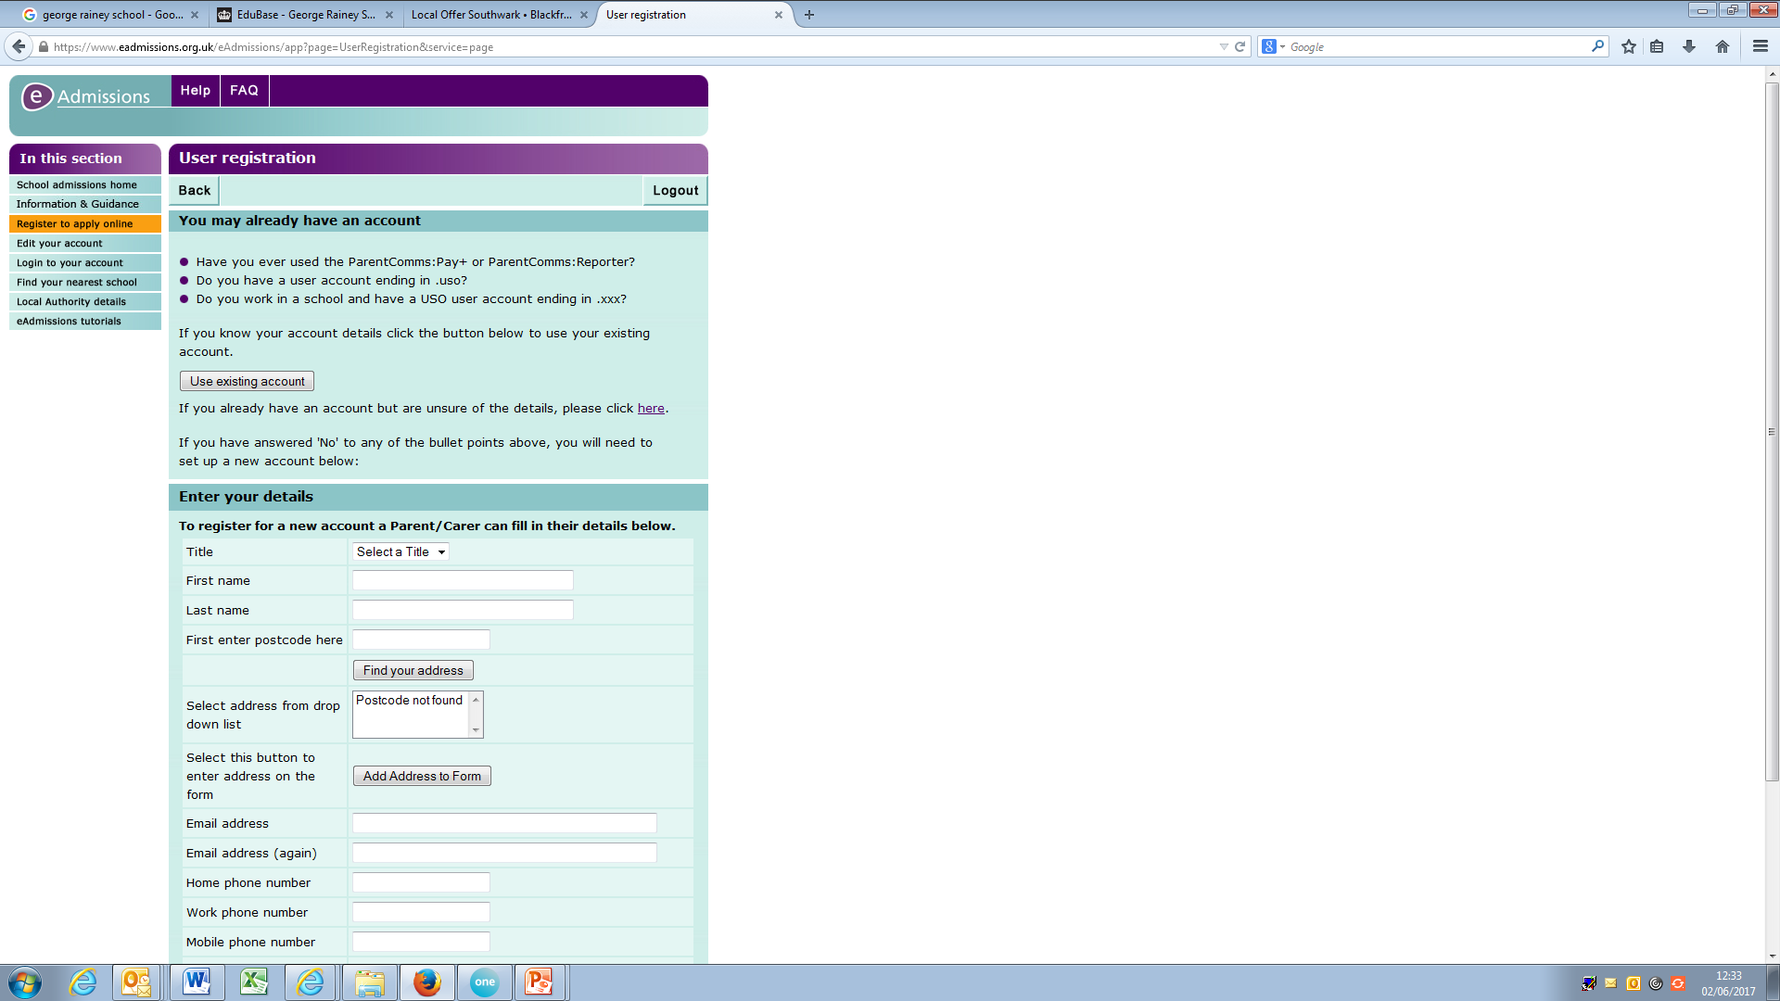
Applying without an EHCP
You will have to complete the E-admissions online form
Preferences are considered individually
You have SIX preferences
It is advised that you use all six preferences
Complete Supplementary Information forms (SIF) where required e.g. Faith school applications

Slide 10
Applying without an EHCP: Oversubscription Criteria
If a community school is oversubscribed, preference will be given to applications from the following:
Children in public care (looked after children)
Children with siblings who are already on roll at the school
Children with exceptional medical, social or psychological needs, where it is agreed by the LA and the headteacher that these can best be addressed at a particular school
Children of permanent staff employed at the school
Children living nearest to the school
Other types of mainstream schools will have their own oversubscription criteria – published on their website

Slide 11
Applying with an EHCP: School Allocation
The Local Authority are likely to agree to your choice of school(s) unless they consider that any of the following applies:
(a) the school or other institution requested is unsuitable for the age, ability, aptitude or special educational needs of the child or young person concerned, or
(b) the attendance of the child or young person at the requested school or other institution would be incompatible with—
  (i) the provision of efficient education for others, or
  (ii) the efficient use of resources.
(From the Children & Families Act 2014)

Slide 12
Key Dates
EHCP
Application deadline: October 2021
Notification of offer: January 2022
Final EHCP with school named: 15th February 2022
Non-EHCP
Application deadline: 31st October 2021
Notification of Offer: 1st March 2022

Slide 13
Appeal Process (EHCP)
Right to appeal – You have 2 months from the date on the decision letter to appeal to tribunal
Grounds of appeal:
  Dispute the contents of the EHCP plan (You can enter into mediation)
  Dispute the school allocated (Mediation does not apply on these grounds)

Slide 14
Appeal Process (without EHCP)
Remain on the waiting list for highest preference schools
Community School appeals are made to Southwark
Academies and Free School appeals are made directly to the schools
Each school set their own deadline as to when the appeal paperwork is to be submitted.

Slide 15
Final Pointers
Think about how your child will fit into any of the schools you are considering
The Year 5 Annual Review is the time to raise any concerns you have about the plan
Visit as many schools as possible and make use of your three choices
DO NOT apply through School Admissions – the application will be rejected and any school offers rejected

Slide 16

Checklist
Visits
Preference
Deadline
Offer and Appeals

Slide 17
SIAS Drop Ins
Sunshine House, 27 Peckham Road, London SE5 8UH (term-time only)
Tuesdays 9am-12pm
Thursdays 3pm-6pm

Slide 18
SIAS Contact details
Tel: 0207 525 3104
Email: SIAS@southwark.gov.uk
Book a slot a the virtual drop in session Tuesdays 9.30am-2pm:
https://calendly.com/southwarkiass

Slide 20
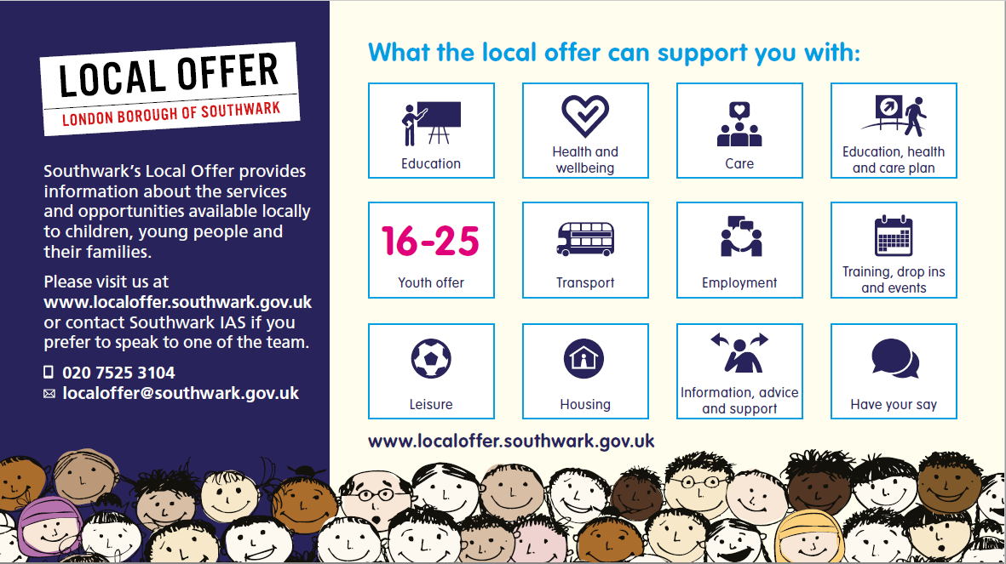
www.localoffer.southwark.gov.uk

